Slide 1

Upskill INDIA Jan-2023
ANALYTICAL REASONING STREAM – SESSION1
To attend the sessions, you need to register using the link:
https://www.openmentor.net/upskill-jan-2023-program#enrollment

Slide 2
Aptitude Tests
Many companies conduct aptitude tests to ensure you draw a reasonable and logical results from the data provided to you which is required for a specific Job Role.
To achieve this, numerical reasoning test will help them understand your ability to analyze and interpret various questions given to you in the form of texts, numerals, tables, graphs and data.

Slide 3
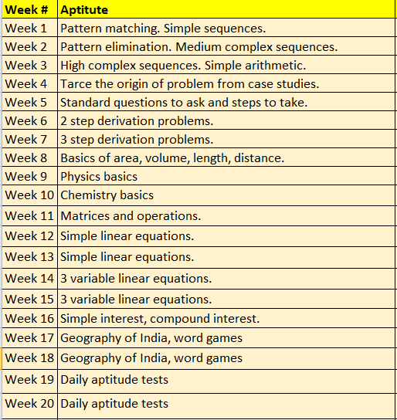
Course Content

Slide 4
Let us quickly see the alphabets sequencing, Natural and whole numbers patterns

Slide 5
1. What comes next?
J, L, N, P, R, T, ?
  X
  V
  A
  Y

Slide 6
1. What comes next?
J, L, N, P, R, T, ?
  X
  V
  A
  Y
A B C D E F G H I J K L M N O P Q R S T U V W X Y Z
So the answer is (b) V

Slide 7
2. Fill the Missing Number
aBEf, bCFg, cDGh, ___
  dEGi
  dHIg
  dEHi
  dHEi

Slide 8
2. Fill the missing number
aBEf, bCFg, cDGh, ____
  dEGi
  dHIg
  dEHi
  dHEi

Slide 9
Example 3
Which one of the four is least like the others?
  Lion
  Cow
  Rabbit
  Deer

Slide 10
Example 1-Answer
Which one of the four is least like the others?
  Lion
  Cow
  Rabbit
  Deer
1. All animals are mammals
2.Cow, Rabbit and Deer are Herbivores
3. Lion is not Herbivores that is a predator
So the answer is (a) Lion

Slide 11
Poll
https://docs.google.com/forms/d/e/1FAIpQLScRLZ5CKDDUyshNzJEQdItyD1C7bRZ67pCmt5cJOxRnRWtB7g/viewform?usp=sf_link

Slide 12
Home Work – Solve yourself
What will complete this sequence?
48, 24, 72, 36, 108, ?
1, 4, 7, 10, 13, 16, 19, ?
10, 15, 19, 22, 24, ?
905, 576, 329, 247, ?
1, 4, 9, 16, 25, ?
1, 2, 8, 9, 15, 16, ?

Slide 13
Numeric Aptitude
Are formed using - Any sequence / series consisting of numbers. These can be formed in different ways.
Addition / subtraction/Multiplication/Division of Numbers
Logical Transportation numbers
Increase or decrease in a specific pattern

Slide 14
4. Find the next Number
Find the next number of the below sequence 30, 29, 27, 24, 20, 15
  8
  11
  9
  10

Slide 15
4. Find the next Number-Answer
Find the next number of the below sequence 30, 29, 27, 24, 20, 15
  8
  11
  9
  10

Slide 16
5. Find the missing number
Find the missing number in the following series out of four: 1, 8, 27,____,125
  37
  64
  47
  54

Slide 17
5. Find the missing number-Answer
Find the missing number in the following series out of four: 1, 8, 27,____,125
  37
  64
  47
  54

Slide 18
Practice problems
What will complete this sequence?
1, 4, 7, 10, 13, 16, 19, ?
10, 15, 19, 22, 24, ?
1, 4, 9, 16, 25, ?
1, 2, 8, 9, 15, 16, ?
48, 24, 72, 36, 108, ?
905, 576, 329, 247, ?

Slide 19
Recordings of the sessions
Videos will be available in the following link
learn.openmentor.net

